Slide 1
MANICURE
MANICURE
Presented by:- Ruchi Chamoli
ruchichamolinvti@gmail.com

Slide 2
MANICURE
The word Manicure is derived from the Latin manus (hand) and cura (care) and means the care of the hands & nails.
The purpose of manicure is to improve the appearance of the Hands and Nails.
The Nails consist of “Keratin” and provide protection for the fingertips. The nails consist of up 150 layers of keratinized skin cells and can reach a thickness of up 0,75 mm.
The fingernails grow about 1 mm per week.

Slide 3
Manicure became particularly popular in France in 1920/1930. This time, it was fashionable to paint the nail tips white and leave the rest of the fingernails in natural rose, which is known as “French Manicure”.
In 1925 a transparent, rose colored nail polish came onto the market. It was only applied to the middle of the nail, the nail tip and the nail moon remained unpainted.
In 1932 the first covering nail varnish was developed by the brothers Lachmann.
Around 1970, the first nail studios were opened and in the early 1980’s the light curing technology was developed.

Slide 4
The care of hands can limit the risk of infections in the nail area. By chew nails or wrong cutting, various diseases such as nail fungus can occur. Therefore professional care is very important.
The first manicures are supposed to have begun 5000 years ago.
In the ancient China paint polish was made of wax, eggs, gelatin and gum arabic.
Cleopatra painted her fingernails with Henna.

Slide 5
NAIL SHAPE
The basic shapes are almond, oval, pointed, round, square, square oval, square with rounded corners, and straight with a rounded tip. The square oval shape is sometimes known as a "squoval", a term coined in 1984. The squoval is considered a strong shape, useful for those who work with their hands.

Slide 6
TYPES OF MANICURE
06 Different Types of Manicures
Basic Manicure
French Manicure
Electric Manicure
Paraffin Wax Manicure
Booth Manicure
Hot Oil Manicure

Slide 7
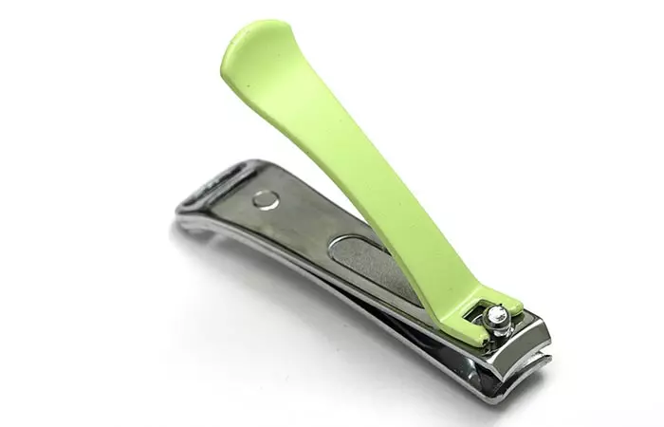
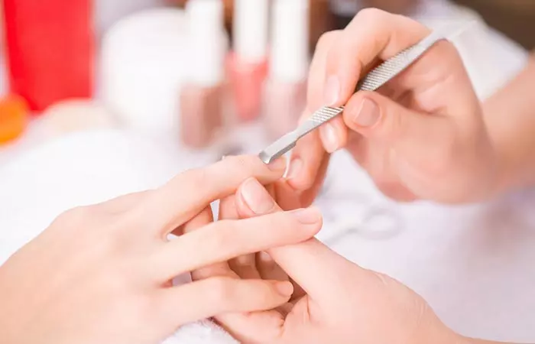
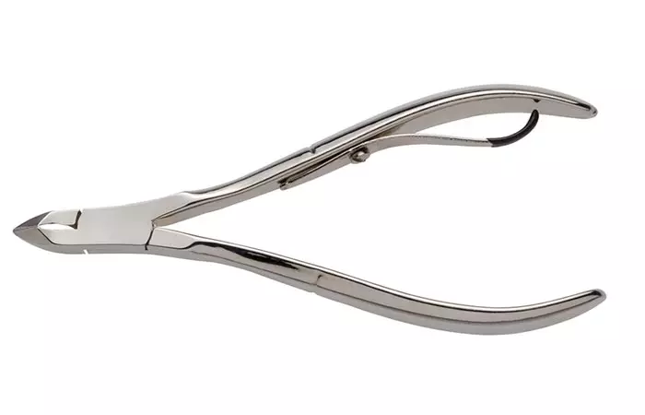
IMPLEMENTS USED IN MANICURE
NAIL CUTTER
CUTICLE PUSHER
CUTICLE NIPPER

Slide 8
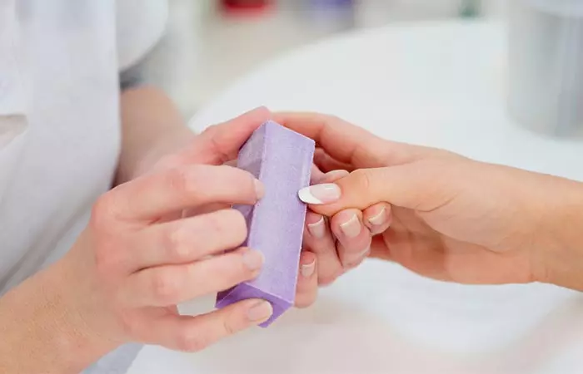
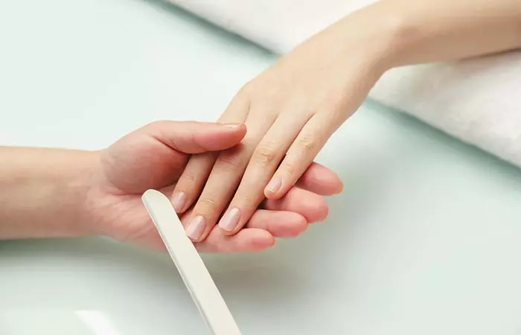
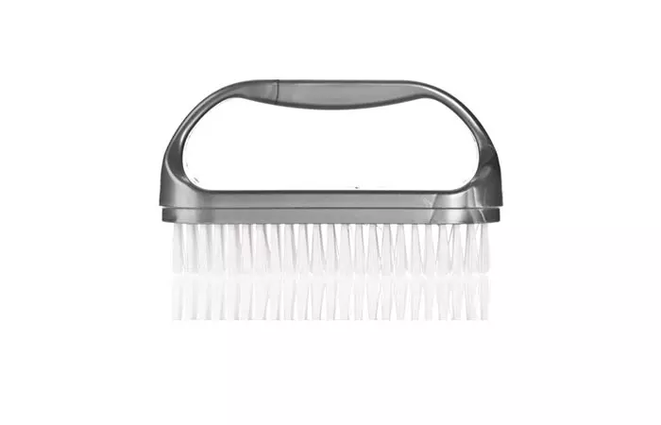
NAIL BUFFER
NAIL FILE
NAIL BRUSH

Slide 9
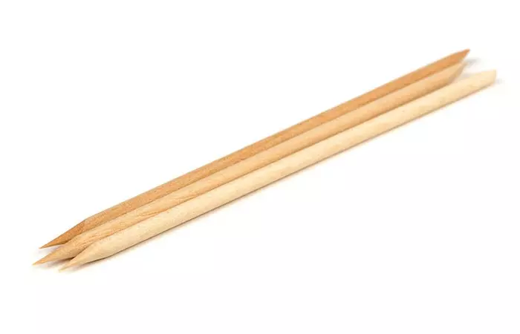
ORANGE WOOD STICK
Other Basic Requirements:
A finger bowl
Warm soapy water
Cuticle oil
Hand cream
Nail Polish (optional)
Mild Scrub
Manicure Table

Slide 10
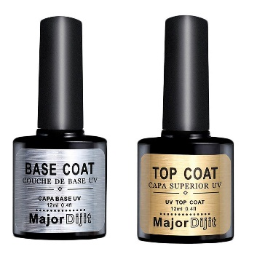
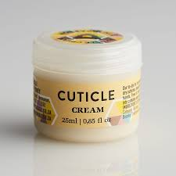
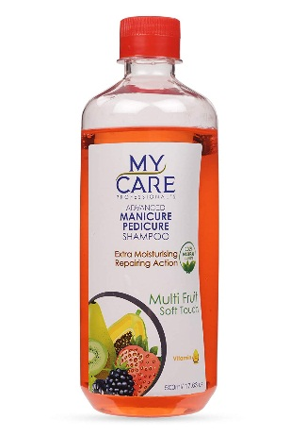
NAIL COSMETICS
Base coat/Top coat
Cuticle Cream
Manicure Shampoo

Slide 11
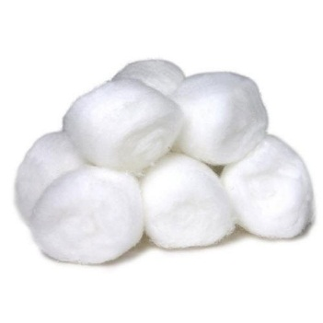
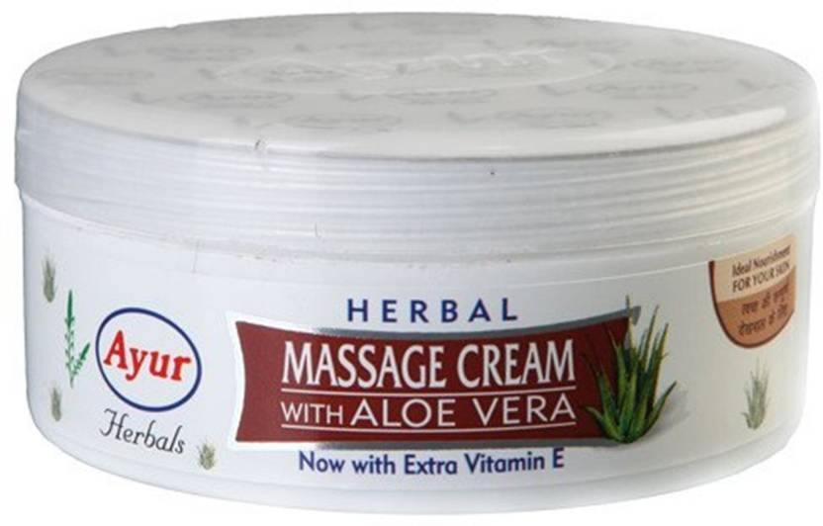
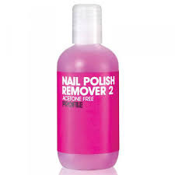
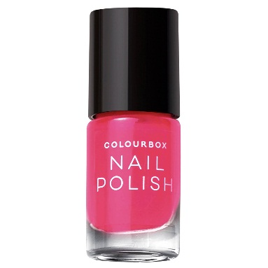
Cotton
Cold Cream
Nail polish remover
Nail paint

Slide 12
Sanitation & Sterilization
All tools, implements, or other pieces of equipment must be properly cleaned and disinfected before coming into direct contact with a client, Some examples are manicuring tabletops and arm cushions, finger bowls, towels, files/buffers, implements, etc.
Always use disposable items- like cotton balls, gauze pads, wooden implements, disposable towels, toe separators, tissues, wooden sticks.
In Australia, the United States, and other countries, many nail salons offer personal nail tool kits for purchase to avoid some of the sanitation issues in the salon. The kits are often kept in the salon and given to the client to take home, or are thrown away after use. They are only used when that client comes in for a treatment.

Slide 13
Procedure
Collect Service related Implements & Cosmetics in Manicure trolley.
Remove any existing nail polish:- Take a couple cotton balls, dip it into a nail polish remover. Gently wipe away the nail polish.
File the nails how your client would like them.
Fill a bowl with sudsy liquid & Soak the client fingers. Take a small bowl and fill it with warm water (make sure it's not too hot). Add in a gentle soap that smells good and moisturizes the skin. This will help with the acetone odor and graying effect and loosen up the dead skin on the nails and cuticles. Most manicure bowls are only for one hand at a time. So while one hand is soaking, you can massage and moisturize the other. Use a scented lotion or massage oil and rub the hand for a few minutes.

Slide 14
Push and trim the cuticles- Use a cuticle pusher and gently push the cuticles back. This will make the nails appear longer and cleaner. After that use a cuticle cutter to trim the skin around the cuticle. Use cuticle cream to soften the cuticle.
Apply massage cream to hydrate and moisturize clients hand and follow the massage manipulation in rhythmic way.
Apply a base coat- It's important to start off with a clear base coat applied thinly, smoothly, and carefully.
Use 1-2 coats of nail polish to cover your nails.
Apply your top coat after your main polish color dries.
Let client nails dry completely .

Slide 15
Safety Precaution
Make sure the salon is licensed and clean.
Never have cuticles cut or pushed back with force.
Don't remove the hair by depilatories and saving, before a Manicure.
Don't cover up nail problems with artificial nails.
Apply a rich moisturizing cream to the nails, particularly after removing nail polish.

Slide 16
A good technician won’t cover your nails with cheap nail polish.
A good manicure should not take less than one hour.
Wooden sticks, Nail file, Cotton and napkins/ Disposable towels can be used only once.
A technician should look neat and maintain an organized workstation.
Technicians must use their tools professionally and be able to work with chemicals.

Slide 17
THANK YOU

